Slide 1

GPs are on your side

Slide 2

Like you, GPs want:

Slide 3
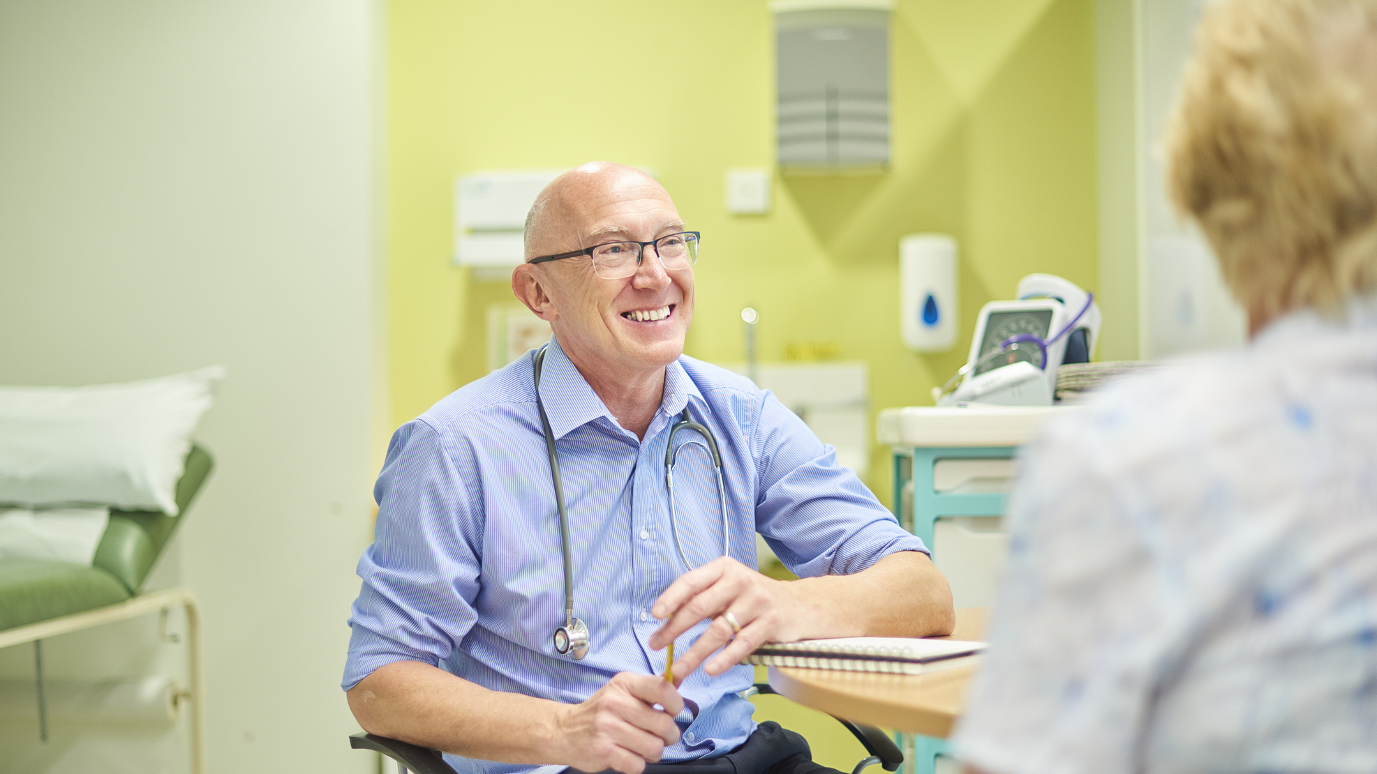

To be there for you whenever you need us.

Slide 4

To deliver continuity of care, and bring back
a time when patients knew their doctors.

Slide 5

To spare patients the anxiety of long waits.

Slide 6
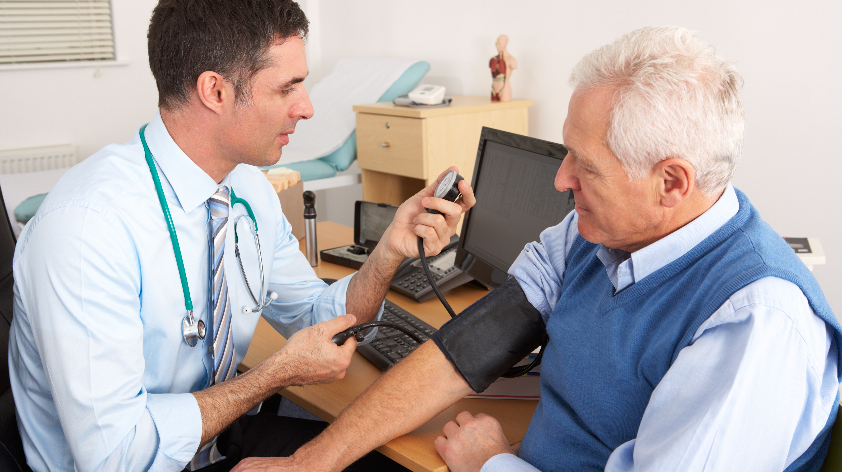
To keep things simple, so patients have the choice to call us up, send us a message
or just walk in.

Slide 7
Why do many patients find it so hard to access their GP?
General Practice is being broken

Slide 8
GPs and their teams are exhausted
and losing morale.
No matter how many hours we work,
we still can’t see all the patients that
need our care.

Slide 9
Since 2015 we have lost over 1,300 surgeries and have 1,400 fewer GPs to care for you
The Government promised us 6,000 more GPs at the last general election, but the numbers are still going down

Slide 10
Those GPs left working in the NHS are overworked and undervalued and feel it is unsafe working in these conditions.
When they leave, it creates a vicious circle where patients struggle to get access.

Slide 11
The average GP practice receives a mere £112.50 per patient each year for essential services – around 31p a day – for unlimited work

Slide 12
The Government have imposed a contract on GPs that is resulting in:
more local practices closing
more GPs leaving
access for patients getting worse and worse

Slide 13
We want patients to
stand side by side with us call for a return to the GP services we used to be proud of.

Slide 14
We need your help in supporting our calls of Government to provide the funding for:
More GPs
More Nurses
More Staff
Modern practice buildings
More appointments for patients

Slide 15
We know patients deserve better than this
GPs Are On Your Side
bma.org.uk/GPsOnYourSide

