Slide 1
BMA-DAUK
RMO Survey 2022
Results Summary

Slide 2
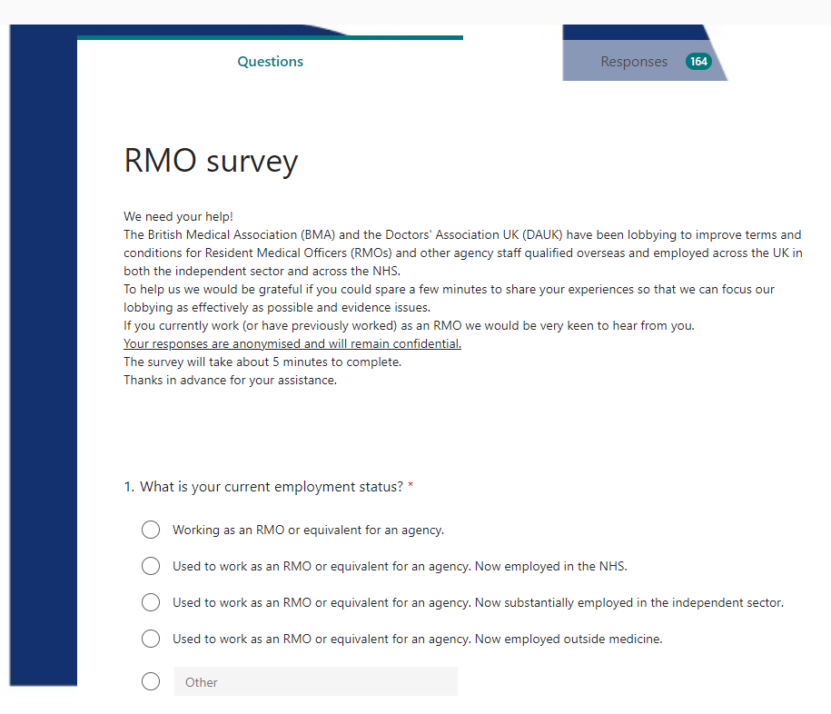
Circulation
Survey open for three weeks between 26/06/22 - 18/07/22
Shared by email, on Facebook and WhatsApp groups via the BMA & Doctors Association UK

Slide 3
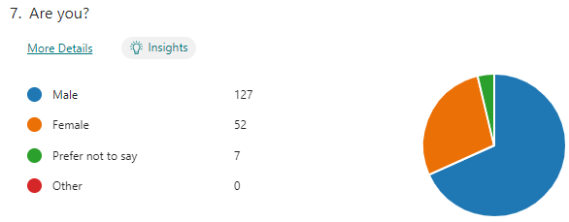
Respondents
Doctors who are currently or previously worked as a resident medical officer (RMO) for an agency
188 respondents
28% female, 68% male
33% were BMA members, 23% DAUK members
45% were members of a medical defence organisation (MDO)
24% not a member of any organisation
92% recruited from Africa
    (50% by word of mouth, 26% directly by agency, 10% attended a course/ event in the UK)
Mostly qualified in Nigeria (81%)
    2% qualified in Ukraine

Slide 4
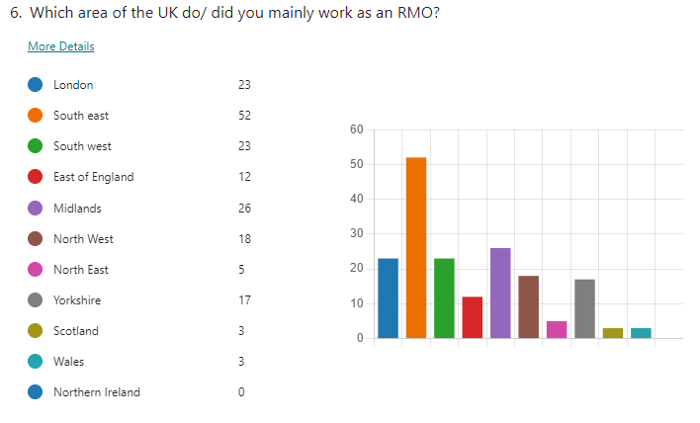
Where do you work?
Just under half (48%) currently working as an RMO
Those previously employed as RMOs are now predominantly working in the NHS
Specialties: Predominantly general practice, psychology and general medicine
Almost all are current or previous NES Healthcare employees
    Others including Reed, RMO International Healthcare, Cape Medical Services
Mostly work/ed at Nuffield (30), Spire (28), BMI (20), Priory (15) Care UK and several private hospitals but over 15% in four South-East NHS Trusts:
- 23 at East Kent Hospitals University NHS Foundation Trust
- Others include Maidstone and Tunbridge Wells, Frimley Health Foundation Trust, Oxford University Hospitals NHS Trust
Largest proportion (28%) work in the South-East but respondents from across the UK

Slide 5
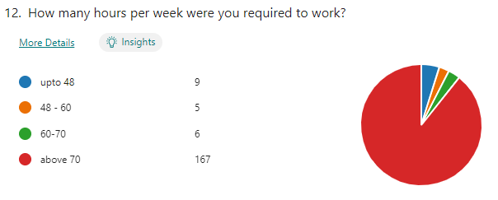
Working hours
89% work above 70 hours (and only 28% opted out of the Working Time Directive voluntarily)

Slide 6
Rating their employer
When asked to rate their employer out of 5, the average rating for their agency was 2.31, and 2.06 out of 5 for pay and terms.
Reasons given for ratings included: exploitation, the employer standing with the hospital rather than individual, being unsupportive, “deceit”, “threats”, “underpaid”, “poor welfare” and “profit-oriented”.
Freetext quotes:
  ”Working with <company name redacted> has been borderline slavery.”
  “They removed me from my hospital on the false accusation when I raised serious concerns about unsafe patient practices.”
  “Rate was less than £11/hr.” (several similar comments)
  “They seek to exploit doctors by any means and give us unfavourable terms and they do this because a lot of doctors want to come [to] practice in the UK.”
  “I feel they are profit-driven to the point that they’d sacrifice the welfare of their doctors to make more money.”
  “They employed underhanded tactics at every opportunity to cut cost.”
  “Low pay , doesn’t care about staff welfare, exploitation.”
A small number reported positive experiences and a well organised company (28/189 gave 4/5 rating). A positive recognised by some respondents was that the agency did help them gain entry to the UK and secure subsequent NHS employment.

Slide 7
Deductions
Respondents reported deductions from their wages, including for:
  Pre-employment training;
  Visas;
  Resuscitation courses - ALS/ ILS/ BLS/ EPALS (many mention that they didn’t require EPALs or ILS);
  Appraisals;
  Arriving late to work;
  Post-shadowing ‘placement week’ (unpaid);
  Days off sick;
  Transport expenses (not refunded).

Slide 8
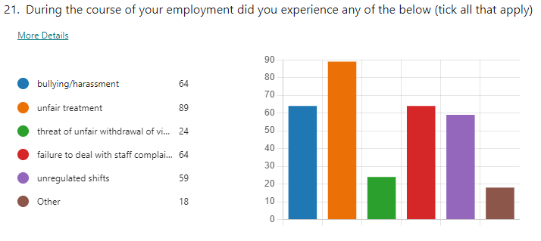
Welfare and patient safety
34% said they experienced bullying and harassment
Many had concerns for patient safety, including fatigue, not meeting rest requirements, working above competencies, prescribing issues, and working without support.
Some shocking reports of exploitation, bullying, racism, unfair deductions, low pay and long (unsafe) hours, as well as complaints not being responded to.

